Slide 1
Somatosensory Pathways:
Anterolateral System

Slide 2
Anterolateral system
Modalities
pain - test by pin-prick
temperature
crude touch, itch, tickle, sexual sensation
Sensitivity to Pin-prick tests for analgesia/hypalgesia/ hypoalgesia in dermatomes; more precise than fine touch
“spinal level” in cord lesions= lowest dermatome with
intact sensation to pin-prick
1st order afferents
C-fibers - slow pain
A-delta fibers - fast pain
synapse in dorsal horn gray matter
2nd order projections neurons
decussate in cord, 1-2 cord segments above dorsal
root entry level
Bottom line: pain info from one side of the body ascends
the opposite side of the cord, unlike DCML
Contains three functionally distinct tracts:
spinothalamic
spinoreticular
spinomesencephalic
Notes:
fdsafdff

Slide 3
Spinothalamic tr.
Right Left
location
Intensity
duration
pain
crude touch
itch
tickle
sexual
sensation
Cerebral
cortex
Thalamus
1= DRG
midbrain
pons
medulla
Spinal cord
Fiber types
A-delta
C
1
Lissauer’s tr.

Slide 4
Spinothalamic tr.
Right Left
Cerebral
cortex
Thalamus
1= DRG
2= dorsal horn
projection neuron
midbrain
pons
medulla
ALS
Spinal cord
Fiber types
A-delta
C
2
Ant. white commissure
of the spinal cord
1
Lissauer’s tr.

Slide 5
Spinothalamic tr.
Mediates
location
intensity
duration
To parietal lobe
Right Left
Cerebral
cortex
4
IC, post. limb
Thalamus
3
1= DRG
2= dorsal horn
projection neuron
3= VPL
4= primary somato-
sensory cx
midbrain
pons
medulla
ALS
Spinal cord
2
Ant. white commissure
of the spinal cord
1
Lissauer’s tr.

Slide 6
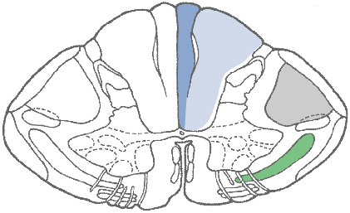
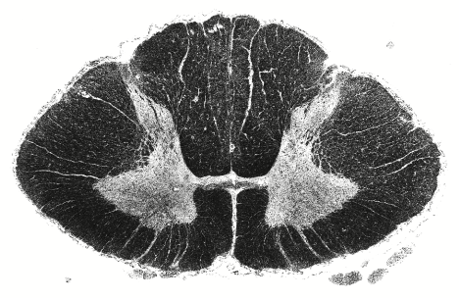
D
Lower
cervical
DMS
DIS
1
2
ant. white comm.
R
L
ALS
Lissauer’s tr.
DF
LF
AF
ALS lies within the
anterior funiculus (AF)
V
A
T
L
S
somatotopic map

Slide 7
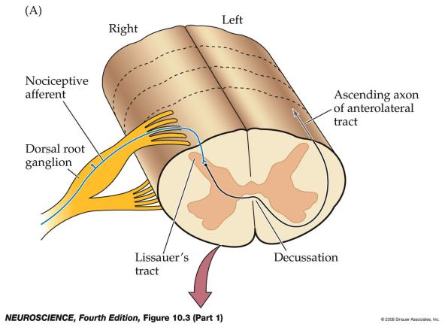
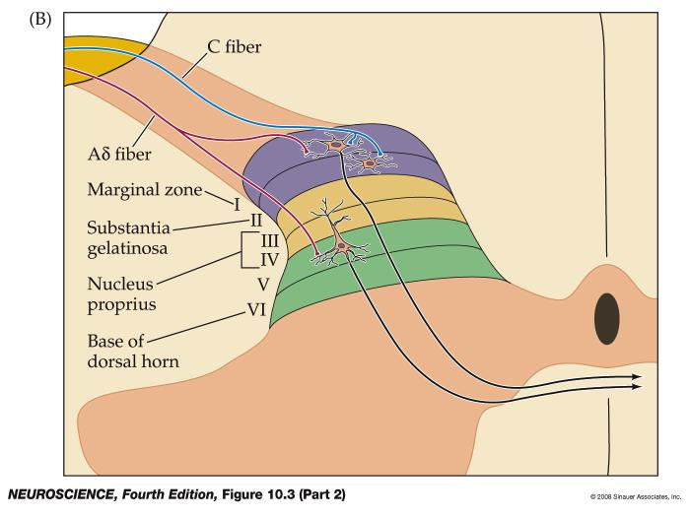
1° afferents synapse in Lamina I and V
Enkephalingeic interneurons in lamina II = substantia gelatinosa

Slide 8
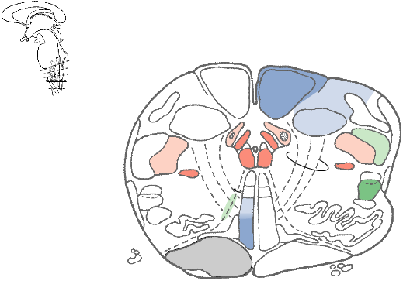
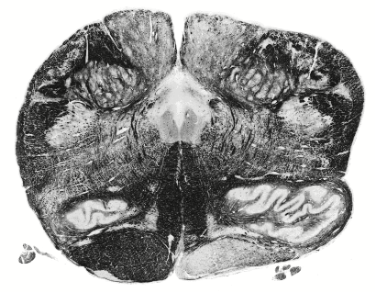
R
L
caudal medulla
ALS
ML

Slide 9
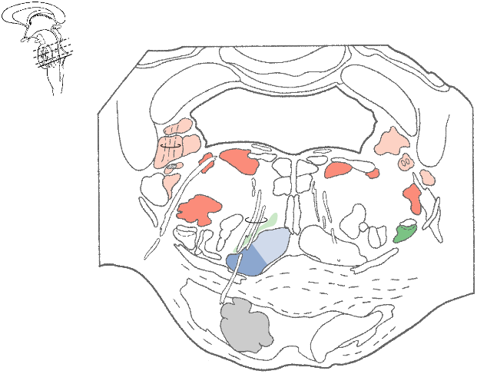
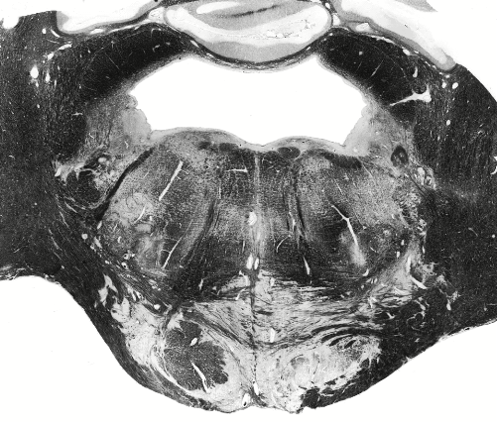
Caudal
pons
ALS
ML

Slide 10
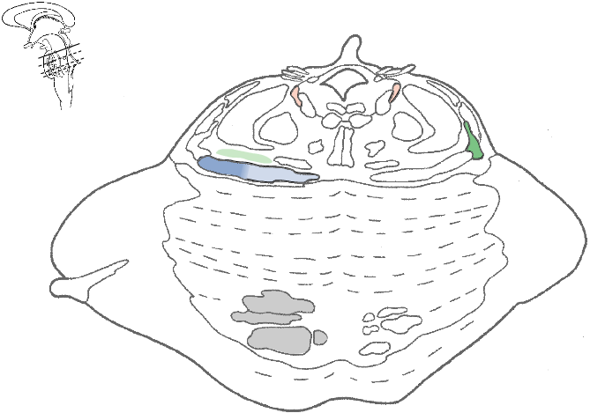
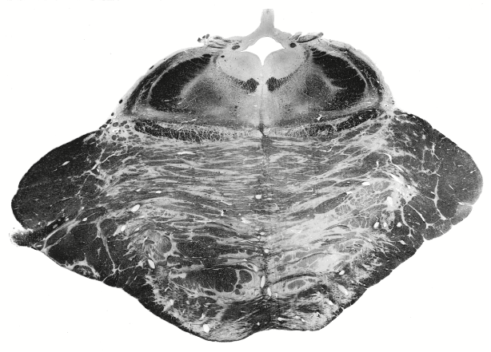
ALS
(spinothalamics)
R
L
Pontomesencephalic
junction
ALS
ML

Slide 11
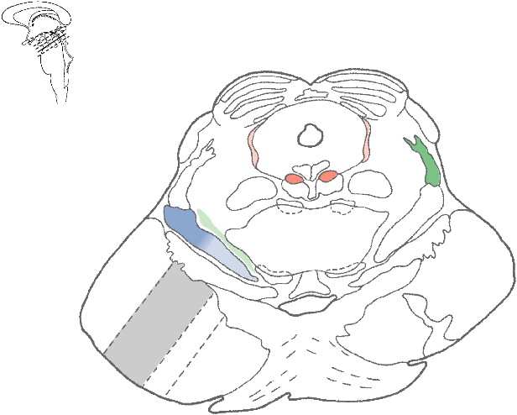
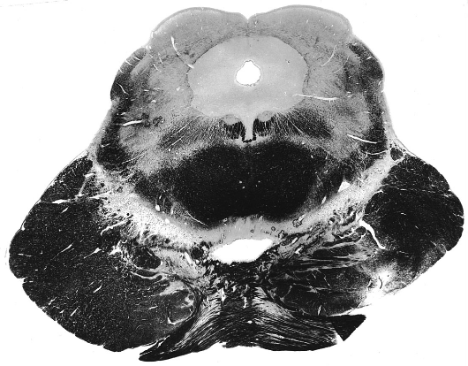
ALS
(spinothal.)
midbrain
ML

Slide 12
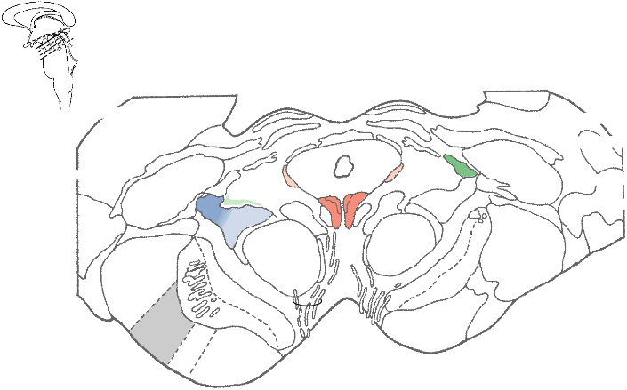
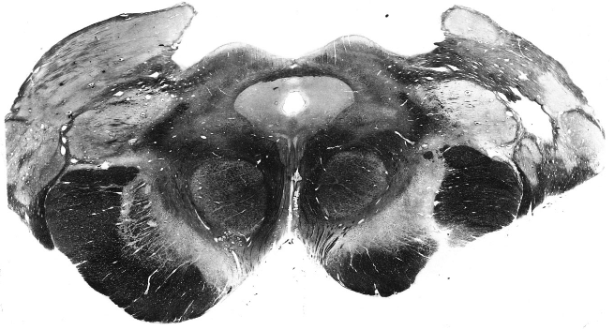
Rostral midbrain

Slide 13
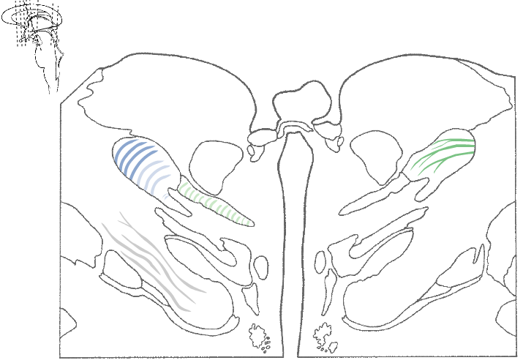
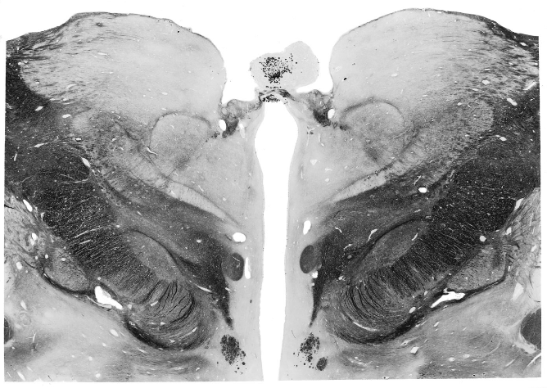
3
thalamus
VPL

Slide 14
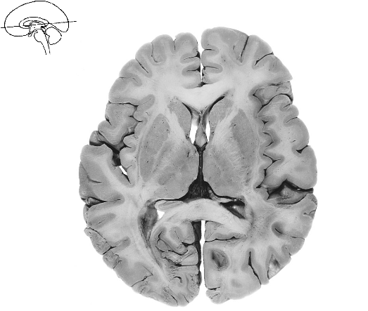
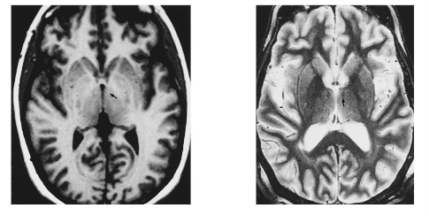
Ascending pathway from contralateral
dermatomes
IC
A
T
L
3
s
VPL

Slide 15
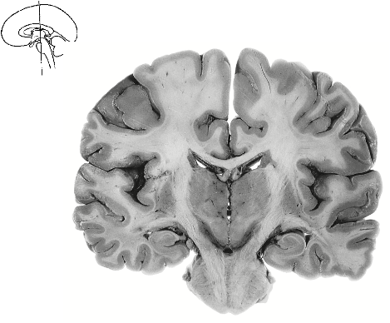
Spinothalamic pathway: cortical termination
3
R
L
3° thalamocortical fibers project to layer IV, postcentral g.
Projections to sensory homunculus specialized for
precise dermatomal localization of stimulus
conveying stimulus intensity and duration

Slide 16
Spinoreticular pathway
Right Left
mediates
arousal
emotion
motivation
To frontal lobe
& limbic system
system
Cerebral
cortex
4
Thalamus
Ant. limb.
internal capsule
1= DRG
2= dorsal horn
projection neuron
3= reticular formation
4= intralminar n.
5= cx
midbrain
3
pons
medulla
ALS
Spinal cord
2
Ant. white commissure
of the spinal cord
Mainly c-fibers
Lissauer’s tr.

Slide 17
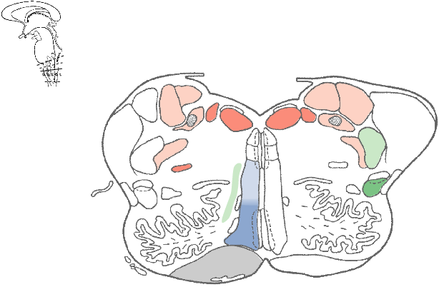
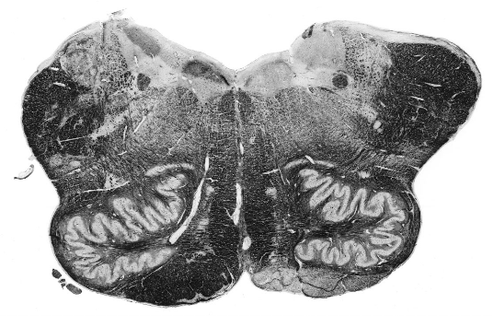
spinoreticular tr.
reticular
formation
ALS
medulla
thalamus
3
Inf. CB
ped.
2
VSCT
ALS
Spinoreticular fibers project into Reticular Formation,
where synaptic networks link pain to cranial motor
programs for: grimace, phonation, movement

Slide 18
Reticulothalamic fibers project to intralaminar
thalamic nuclei, e.g. centromedian n. (CM)
To diffuse cortical targets
4
CM
VPL
3
medullary/pontine RF
Thalamocortical projections from CM in turn project
to structures mediating pain-associated responses:
amygdala (fear)
hypothalamus (fight-or-flight)
ant. cingulate cx & ant. insula (misery index, mood)
frontal lobe – language cx, prefrontal cortex
(@!!**#!, avoidance, judgment)

Slide 19
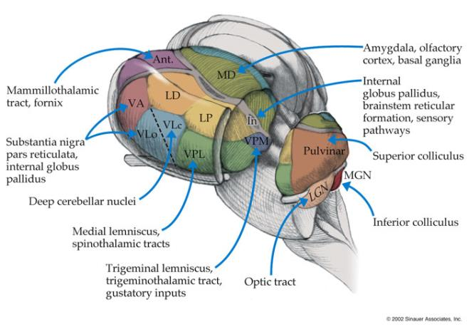
Location of the intralaminar nuclei vs VPL

Slide 20
Thalamocortical neurons carrying spinoreticular input ascend through the internal capsule, anterior limb
3

Slide 21
Spinomesencephalic tr.
Mediates central
modulation of pain
Activates
descending
analgesic
pathways
Right Left
Cerebral
cortex
Thalamus
3
Afferent pathway
1= DRG
2= dorsal horn
3= periaqueductal
gray
midbrain
pons
medulla
ALS
Spinal cord
2
1
Ant. white commissure
of the spinal cord
A-δ fibers

Slide 22
Spinomesencephalic tr.
periaqueductal
gray (PAG)
spinomesenceph.
terminations
midbrain
ALS
(spinothal.)
2
terminates in PAG
regulates activity of small PAG interneurons producing
endogenous opioid peptides: enkephalins, endorphins,
dynorphins, endogenous cannabinoids

Slide 23
Spinomesencephalic tr.
stimulates descending analgesic pathway
periaqueductal
gray (PAG)
spinomesenceph.
terminations
midbrain
ALS
(spinothal.)
terminates in PAG
regulates activity of small PAG interneurons producing
endogenous opioid peptides: enkephalins, endorphins,
dynorphins, endogenous cannabinoids
activates descending pain-inhibitory pathway
Notes:
23

Slide 24
Descending analgesic pathways arise from midbrain PAG**
PAG packed with small opioid peptide-producing
interneurons and neurons with cannabinoid receptors
spino-
mesencephalic tr.
+
midbrain
PAG
GLU
pons
+
medulla
Spinal cord
PAG
= endorphinergic
**PAG = one of 3 CNS sites (also dorsal horn, limbic ctrs)
where opioid peptides and opiate drugs mediate pain

Slide 25
Two descending analgesic pathways
1.
Descending noradrenergic mechanism
PAG neurons excite locus ceruleus
NE projections descend to dorsal horn
Pre-synaptically inhibit 1°pain afferents
midbrain
GLU
PAG
LC
+
pons
medulla
NE
Spinal cord
LC = locus ceruleus
2= dorsal horn pain
projection neuron
1° pain afferent
GLU
Sub. P
(-)
(+)
2
ALS projection neuron
NE gates K⁺ efflux through presynaptic α2 receptors
Hyperpolarizes pain afferent terminals, thereby blocking
Ca⁺² influx-mediated Glu release

Slide 26
Two descending analgesic pathways
2.
Descending serotonergic mechanism
GLU neurons co-activate descending 5-HT neurons
in nucleus raphe magnus (NRM) in medulla
5-HT neurons excite enkephalinergic interneurons in
dorsal horn
ENK neurons inhibit 2° pain projections neurons
midbrain
GLU
PAG
LC
+
pons
+
medulla
NRM
NE
Spinal cord
5-HT
LC = locus ceruleus
NRM = n. raphe magnus
2= dorsal horn projection
neuron
5-HT
1° pain afferent
GLU
Sub. P
(-)
(+)
(+)
(-)
enkephalinergic
interneuron
2
ALS projection neuron

Slide 27
Two descending analgesic pathways
2.
Descending serotonergic mechanism
GLU neurons co-activate descending 5-HT neurons
in nucleus raphe magnus (NRM) in medulla
5-HT neurons excite enkephalinergic interneurons in
dorsal horn
ENK neurons inhibit 2° pain projections neurons
midbrain
GLU
PAG
LC
+
pons
+
medulla
NRM
NE
Spinal cord
5-HT
LC = locus ceruleus
NRM = n. raphe magnus
2= dorsal horn projection
neuron
5-HT
1° pain afferent
GLU
Sub. P
(-)
(+)
(+)
(-)
enkephalinergic
interneuron
2
Substantia
gelatinosa
ALS projection neuron

Slide 28
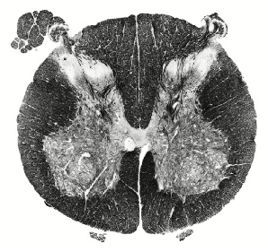
substantia
gelatinosa

Slide 29
Experimental analgesia - cannabinoids
Opioid and cannabinoid infusion into PAG (or dorsal
horn or limbic centers stimulates endogenous analgesic
pathways) – RAISE PAIN THRESHOLD
spinomesen. tr.
midbrain
GLU
PAG
LC
+
pons
drug
+
medulla
NRM
NE
Spinal cord
5-HT
LC = locus ceruleus
NRM = n. raphe magnus
2= dorsal horn projection
neuron
5-HT
1° pain afferent
GLU
Sub. P
(-)
(+)
(+)
(-)
enkephalinergic
interneurons
2
drug
ALS projection neuron

Slide 30
Limbic inputs can up-regulate descending
analgesic systems
amygdala projects to PAG
centrally activates descending analgesic system
in fight-or-flight response
Frontal cx**
amygdala
+
midbrain
GLU
PAG
fear
+
pons
LC
LC
+
medulla
NRM
NE
Spinal cord
5-HT
LC = locus ceruleus
NRM = n. raphe magnus
C= dorsal horn
(substantia gelatinosa)
5-HT
1° pain afferent
GLU
Sub. P
(-)
(+)
(+)
(-)
enkephalinergic
interneuron
C
2° ALS projection neuron
**Frontal cortical projections to PAG regulate placebo and
nocebo effects that determine descending system function

Slide 31
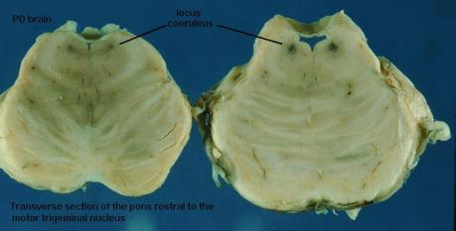
Locus ceruleus
rostral pontine tegmentum
neuromelanin pigment
brain’s only noradrenergic n.
Dorsal (medullary) raphe nuclei
bilaterally symmetric nuclei bracket midline
obscured by medial lemniscus
projections descend as serotonergic raphespinal
fibers
4th V
ML
Locus
coeruleus
raphe n.

Slide 32
“Psychosomatic” pain
historically deemed imaginary; faking illness for
psychiatric reasons
Depression and aches and pain
Global deficit in NE- or 5HT-receptor signaling
defective descending analgesic pathways
decreased pain threshold
defective ascending projections from the LC and
raphe to frontal lobe and limbic system manifest as
psychiatric mood/anxiety d/o’s
Fibromyalgia
long-term disorder: chronic body-wide pain,
depression, anxiety, sleep disturbances,
headaches, prevalence in females
proposed down-regulation of descending
analgesic systems caused decreased pain threshold
duloxetine (e.g. Cymbalta™)
5HT/NE uptake inhibitor (SNRI)
First FDA-approved antidepressant for treatment
of fibromyalgia associated neuropathic pain
and depression
Goal: elevate [NE/5HT] in dorsal horn

Slide 33
Neuropathic pain syndromes
Damage/dysfunction of pain afferents or CNS pain pathways
Phantom limb
see with amputation or congenital absence
compensatory overactivity of 2° and 3° neurons still somatotopically dedicated to deafferentiated limb
fooling the visual system can reduce the pain
Multiple sclerosis
demyelinated axons ⇑ v-gated Na⁺ channel density
increased probability of epiphatic crosstalk from demyelinated afferents (DC modalities) to pain afferents in dorsal root or horn
Thalamic pain syndrome
lacunar infarct of thalamus-one side
contralateral allodynia
Herpes zoster (shingles)
post-herpetic neuralgia big problem as damaged
afferents regenerate; allodynia
Diabetic neuropathy - #1 cause (deafferentiation)
Trigeminal and glossopharyngeal neuralgias
vascular compression of nerve roots
Surgical intervention
rhizotomy - chemical or surgical ablation of nerve root
ALS tractotomy
stereotaxic ablation of thalamic nuclei

Slide 34
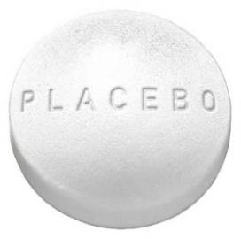
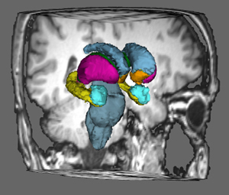
EFFECT
Real phenomenon
Sensory cx sees, smells, tastes or feels stimulus that5 looks like a dosage form
Association cortices relay information to brain’s Reward Center = Nucleus Accumbens
NA relays info to the PAG to elevate the descending analgesic pathway activity
NA

Slide 35

Nocebo effect
Anticipation of pain heightens perception
of otherwise minor stimulus
Amygdala ➔ PAG ➔reduces activity of descending
analgesics ➔decreases pain threshold

Slide 36
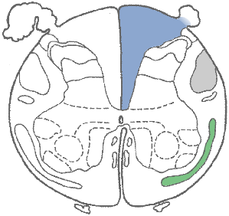
Visceral pain
poorly alleviated by ALS tractotomy
newer, alternate pathway discovered
ascends in DCs
2° post-synaptic Dorsal Column Neurons (PDCN) arise deep in dorsal horn
General visceral
afferents
mainly abdominal
origin
FG

Slide 37
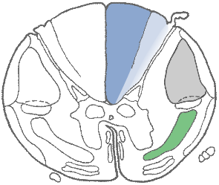
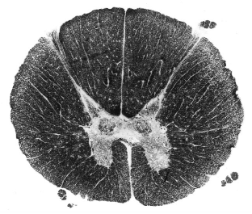
“Post-synaptic
dorsal column neurons”
= 2° neurons for
visceral pain
D
T
thoracic
viscera info
ascends in FC
FG
FC
V

Slide 38
Visceral pain uses a DC-ML pathway
to VPL, then projects to insular cx
Right Left
Cerebral
cortex
(insular cx)
4
Thalamus-VPL
medial lemniscus
midbrain
pons
Brainstem
medulla
3
int. arcuate fibers
= sensory decuss.
PSDCNs
2
1
1= DRG
2 = PSDCN
3 = N. gracilis
N. cuneatus
4 = VPL
Notes:
38
38

Slide 39
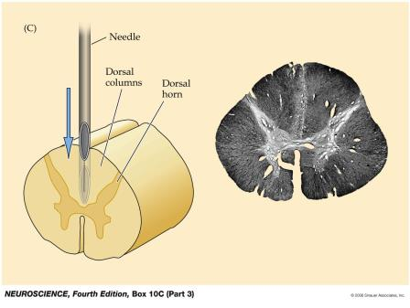
Important points about PSDCNs
Inhaled general anesthetics (propofol, halothane, isoflurane) down-regulation PSDCNs
Work indirectly by enhancing activity of surrounding GABAergic/glycinergic interneuons
Decrease PSDCN firing via their activation of GABA receptors, leading to loss of visceral sensation
Midline myelotomy alleviates intractable pain
in bowel cancer patients

Slide 40
What are the sensory deficits resulting
from this stab injury at cord level T6?
R
L
Lesion level: mid-thoracic – cord level T6
Deficits:
DC modalities - ipsilateral sensory loss
including and below T6 nerve root level
ALS modalities - contralateral loss beginning
1-2 segments below lesion (and below)
Ablation of dorsal horn causes ipsilateral loss
of incoming sensation via T6 nerve root +
ipsilateral band of analgesia extending to
T7-T8

Slide 41
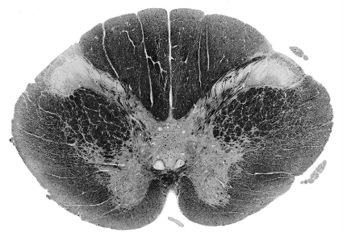
What are the sensory deficits resulting
from this small cavitation of 3-4mm?
R
L
Lesion level: cord level C2
Deficits:
DC modalities intact
ALS modalities - bilateral loss of pain/temp
sensation with a cape-like distribution at
~C3-C4
ALS modalities intact in dermatomes
represented above and below the lesion
because ALS intact

Slide 42
By the end of this lesson students will be able to:
Draw and explain in detail the anatomy and decussation of the ALS, and compare the anatomic relays and functions of the spino-thalamic, spinoreticular and spinomesencephalic divisions
Draw and describe the anatomy of the descending analgesic systems
Distinguish pre- and post-synaptic inhibition of pain afferents in the dorsal horn
Discuss the pharmacologic relationship to mood and somatic disorders of the descending analgesic systems
Draw and explain the visceral pain pathway to cortex and the significance of the post-synaptic dorsal column neuron to general anesthetic effects
Define neuropathic pain as it relates to phantom limb pain, MS and post-herpetic neuralgia, and discuss current therapeutic options
Discus the neurologic basis for placebo effects
Discuss the neurologic basis for fear-mediated pain suppression
Identify the PAG as an important convergence area for endocannabinoid an opiate regulation
Identify the three sites of opioid production and opiate effects in the CNS

